Slide 1
INTRODUCTION TO THE COURSE

Slide 2
ISTQB
ISTQB (International Software Testing Qualifications Board)
It offers many certificates in software testing
ISTQB website

Slide 3
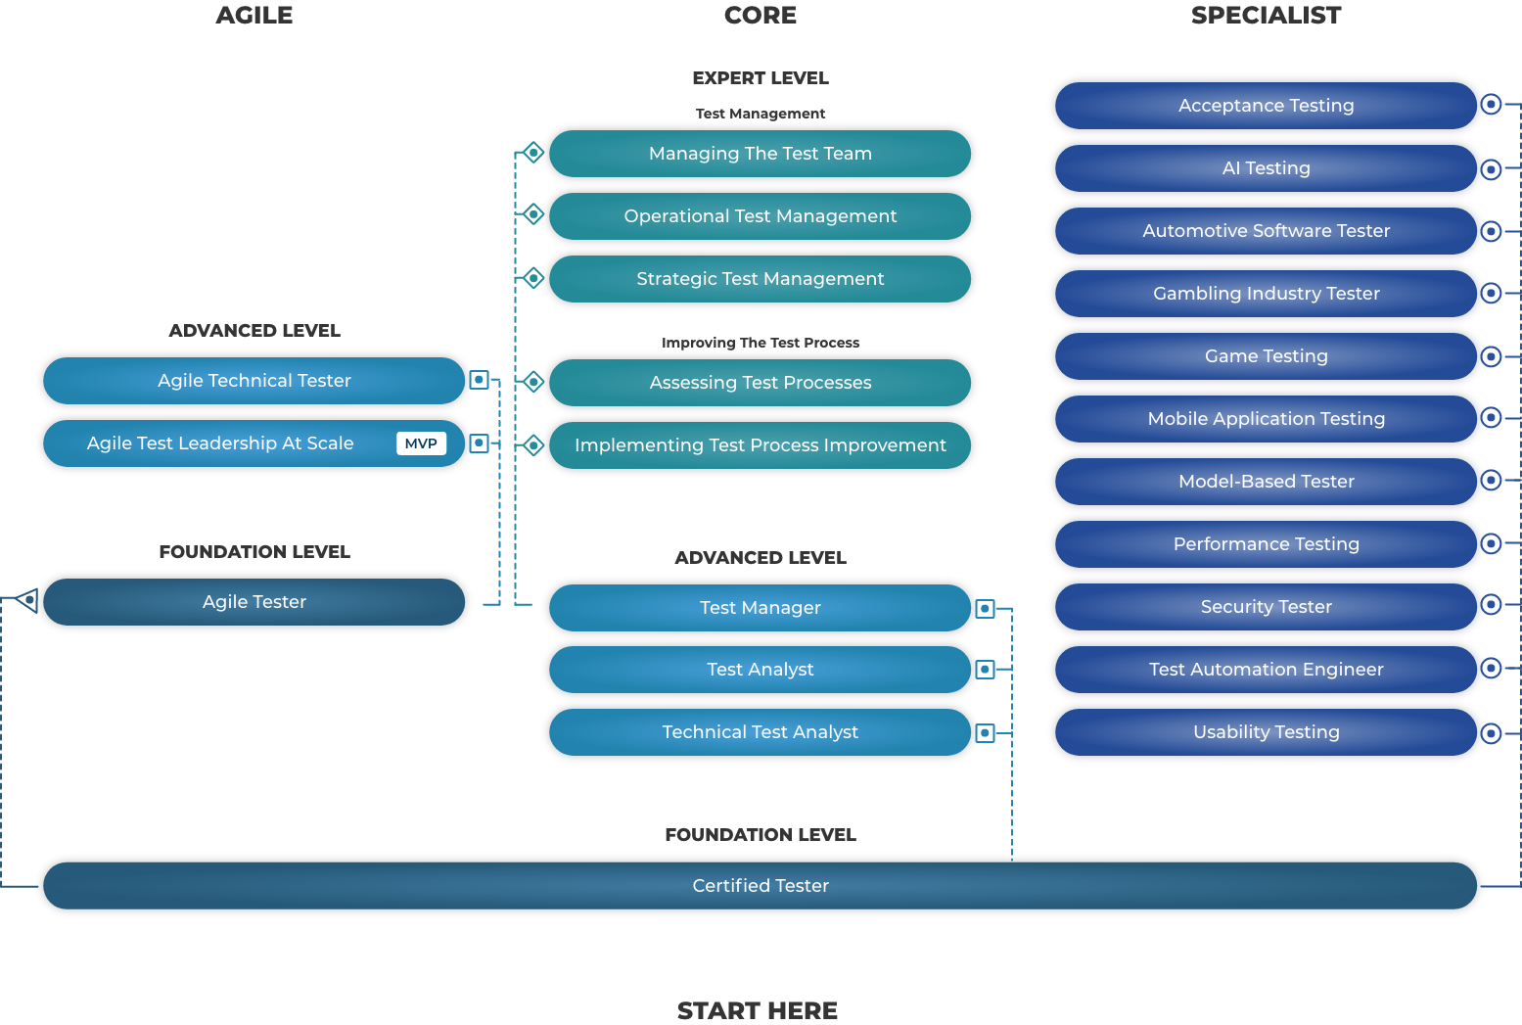
ROAD MAP IN SOFTWARE TESTING DOMAIN

Slide 4
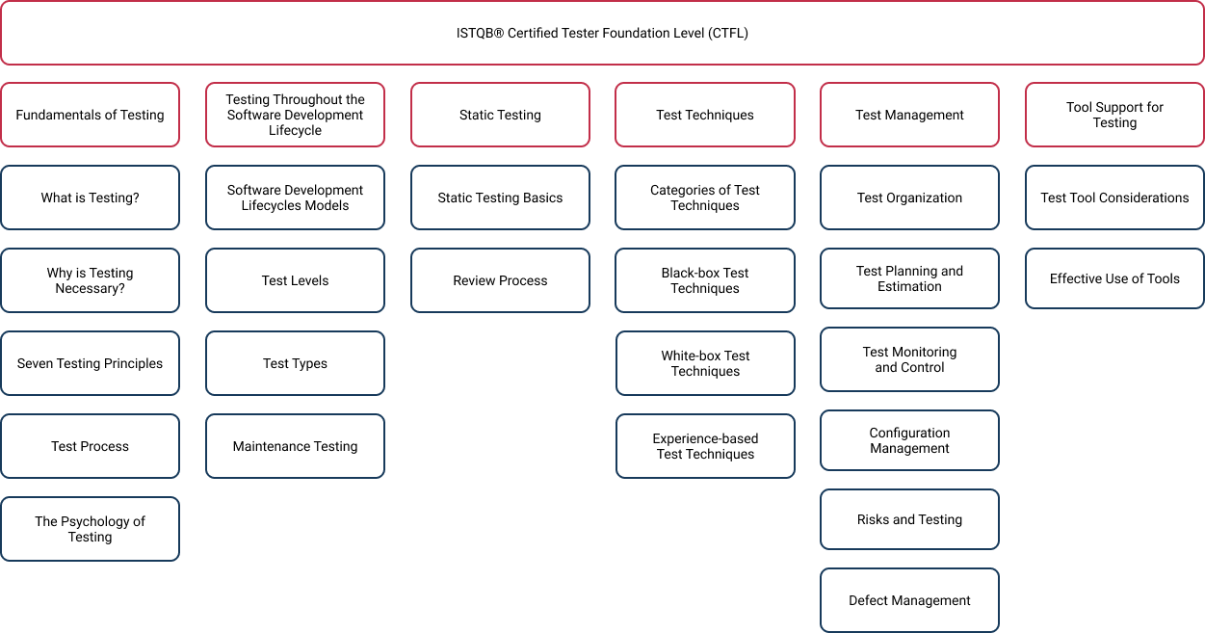
COURSE CONTENT

Slide 5
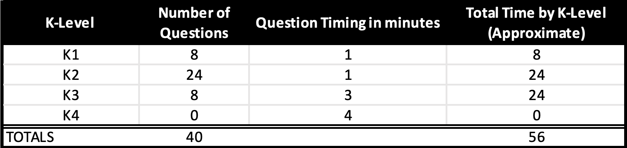
Preparing for the Exam
Exam Structure

Slide 6
Preparing for the Exam
40 single-choice questions from K1 to K4, require 26/40 (65%) to pass.
08 questions of K1 (remember)
24 questions of K2 (understand)
08 questions of K3 (apply) and K4 (analyse)
75 minutes for non-native speakers
No scores in the Certificate
No Expiration

Slide 7
Preparing for the Exam
Questions per chapter
C1: 08 questions
C2: 05 questions
C3: 05 questions
C4: 11 questions
C5: 09 questions
C6: 02 questions

Slide 8
Audience
The Foundation Level syllabus forms the basis of the International Software Testing Qualifications Board (ISTQB®) Certified Tester Scheme. The exam and the Syllabus
ISTQB® Foundation Level is relevant across software delivery practices including Waterfall, Agile, DevOps and Continuous Delivery.
Foundation Level qualification is suitable for anyone who needs to demonstrate practical knowledge of the fundamental concepts of software testing including people in roles such as testers, test analysts, test engineers, test consultants, test managers, user acceptance testers and software developers.

Slide 9
Business Outcomes
Promote efficient and effective communication by using a common vocabulary for software testing.
Understand fundamental concepts of software testing.
Demonstrate understanding of how different development and testing practices, and different constraints on testing, may apply in optimizing testing to different contexts.
Contribute effectively to reviews.
Use established techniques for designing tests at all test levels.
Interpret and execute tests from given test specifications. Report on test results.

Slide 10
Business Outcomes (cont.)
Understand test management principles for resources, strategies, planning, project control and risk management
Write and communicate clear and understandable defect reports
Understand the project factors that drive the test priorities and test approach
Understand the value that software testing brings to stakeholders
Appreciate how testing activities and work products align with project objectives, measures and targets
Assist in the selection and implementation process of testing tool

Slide 11
Learning Objectives
K1
remember, recognize, recall (15)
K2
understand, explain, give reasons, compare, classify, categorize, give examples, summarize (40)
K3
apply, use (7)
K4
analyze

Slide 12
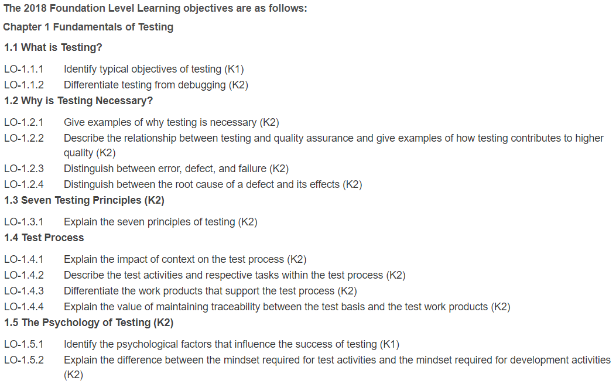
Learning Objectives

Slide 13
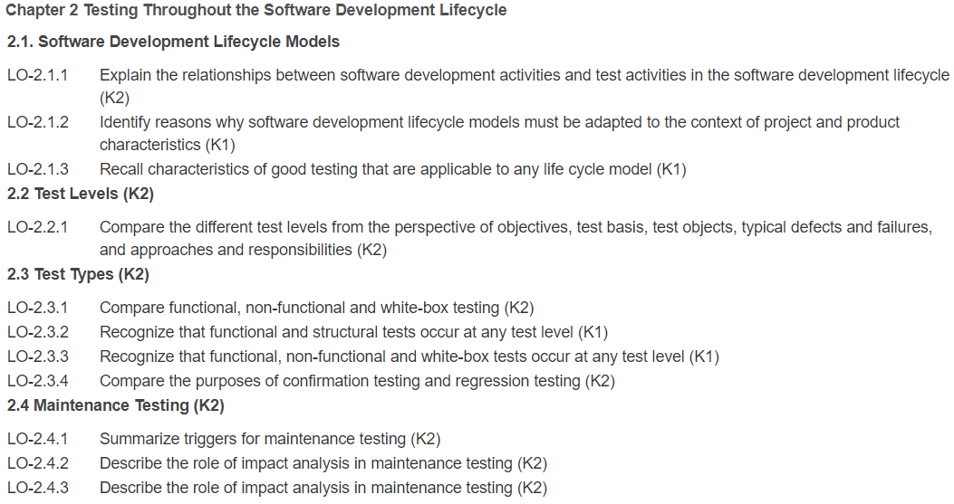
Learning Objectives

Slide 14
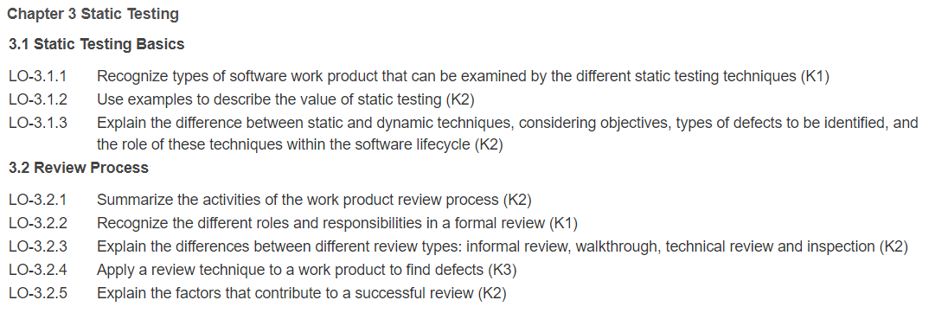
Learning Objectives

Slide 15
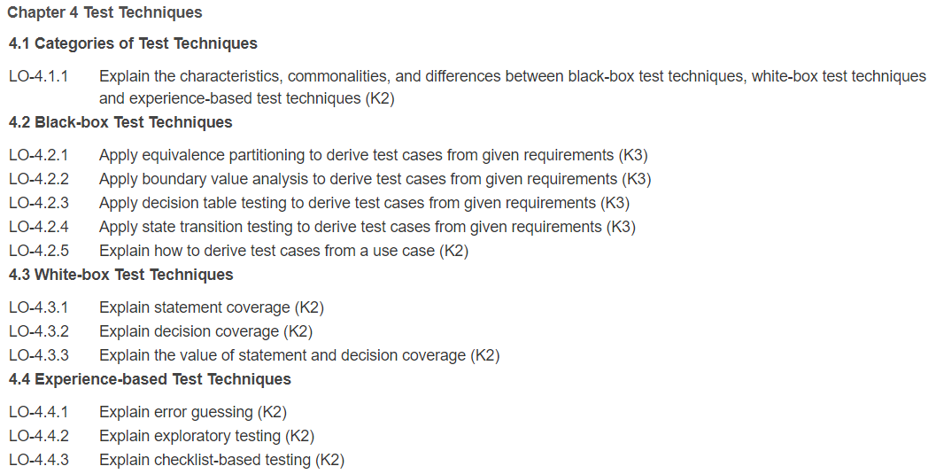
Learning Objectives

Slide 16
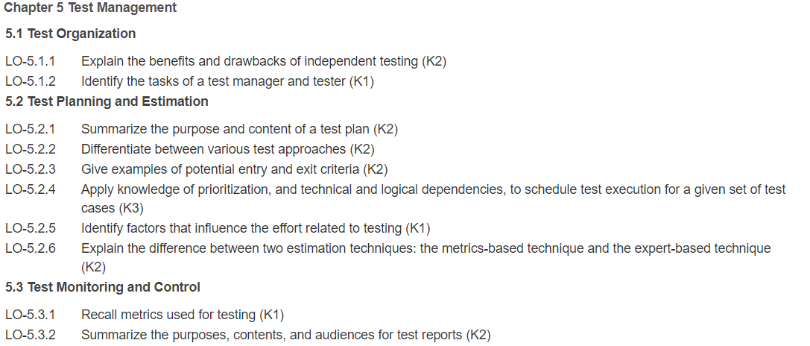
Learning Objectives

Slide 17
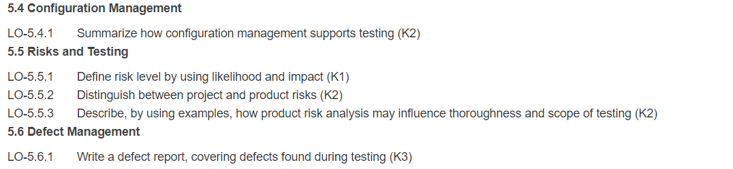
Learning Objectives

Slide 18
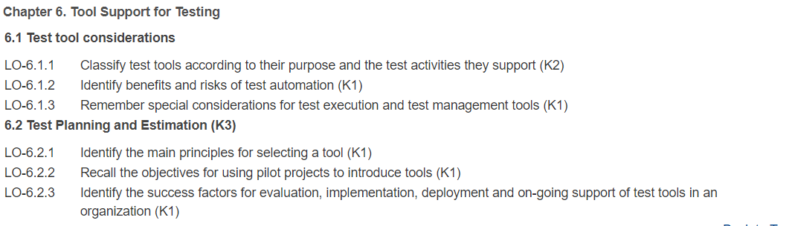
Learning Objectives

Slide 19
Taking the Exam
Multiple-Choice Test Taking Tips and Strategies:
#1: Read the entire question.
#2: Answer it in your mind first.
#3: Eliminate wrong answers.
#4: Use the process of elimination.
#5: Select the best answer.
#6: Read every answer option.
#7: Answer the questions you know first.

Slide 20
Taking the Exam
#8: Make an educated guess.
#9: It's usually best to stick with your first choice--but not always.
#10: "All of the above" and "None of the above"
#11: When there are seemingly two correct answers.
#12: Place your bet on the positive option.
#13: The more information... the better.

Slide 21
SUMMARY
Preparing for the Exam
Taking the Exam

